Slide 1
Colors

Slide 2
blue

Slide 3
The cup is blue.

Slide 4
green

Slide 5
The leaves are green.

Slide 6
red

Slide 7
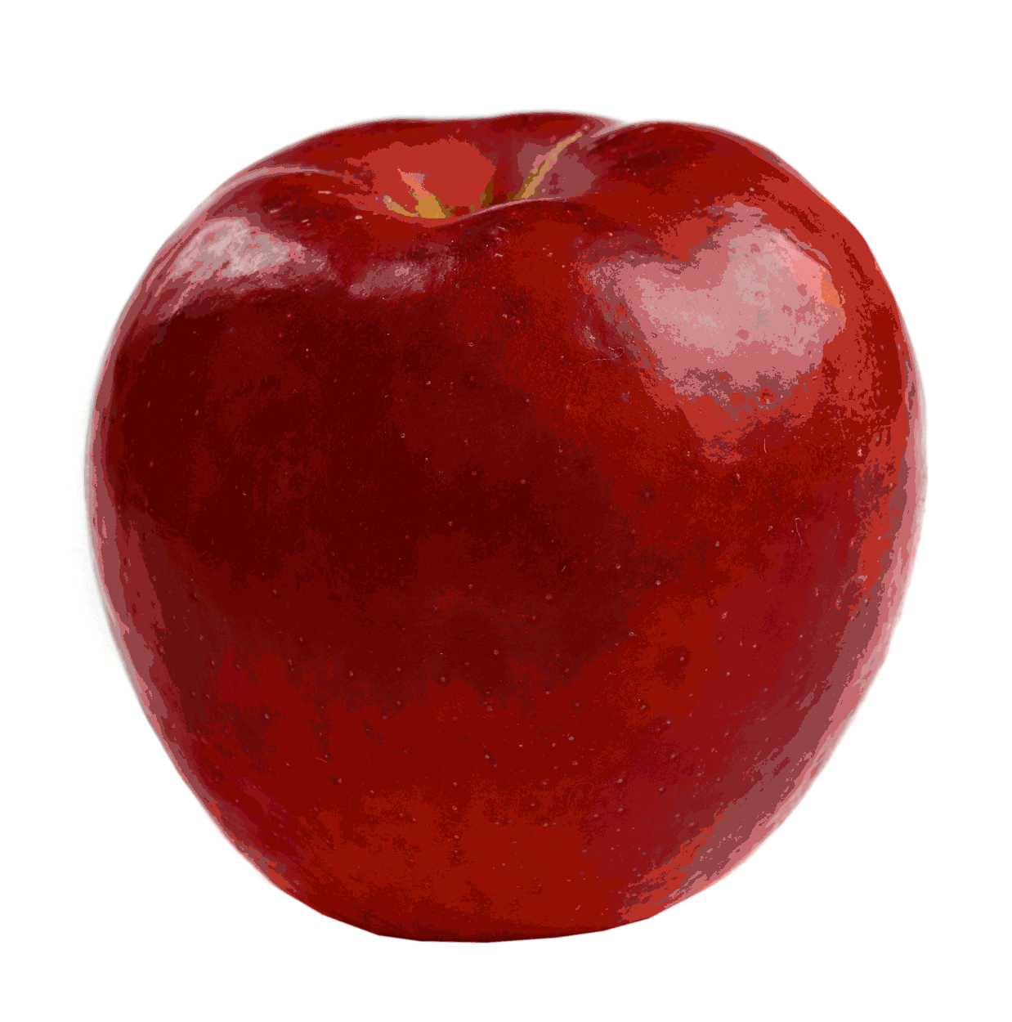
The apple is red.

Slide 8
black

Slide 9
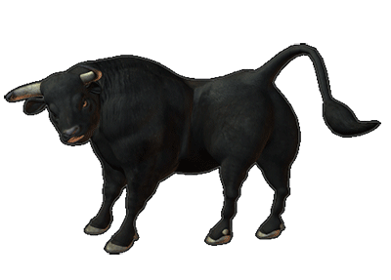
The bull is black.

Slide 10
pink

Slide 11
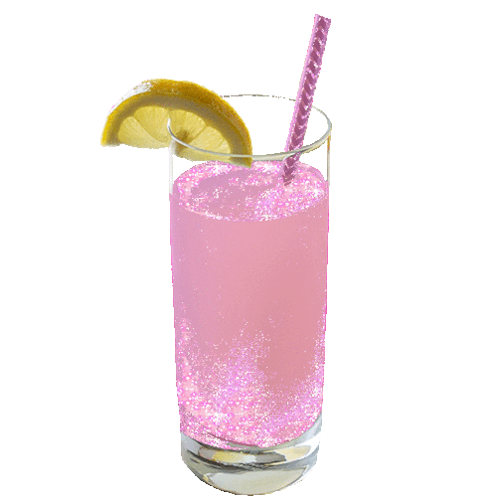
The drink is pink.

Slide 12
yellow

Slide 13
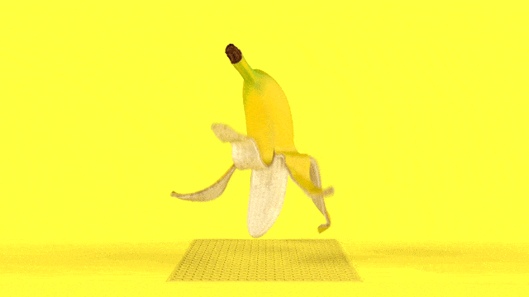
The banana is yellow.

Slide 14
white

Slide 15
The snow man is white.

Slide 16
orange

Slide 17
The car is orange.

Slide 18
grey

Slide 19
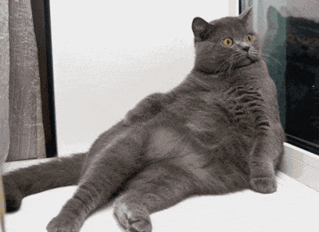
The cat is grey.

Slide 20
brown

Slide 21
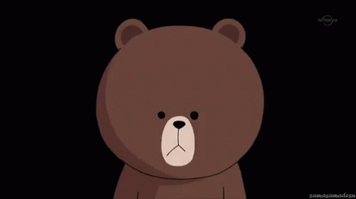
The bear is brown.

Slide 22
purple

Slide 23
The book is purple.

Slide 24
brown
purple
blue
black
white
green
pink
orange
red
yellow
grey

